Slide 1


Thesis Title:
Business IoT Issues for the Automation of Residential Buildings
Supervisor: Ing. Vojtěch Novák, Ph.D
By: Mahdi Houshangi (ID: xhoum029)
Department of Information Technologies , CZU, PEF
Spring, 2025
Notes:
Good afternoon esteemed faculty members. My name is Mahdi Houshangi, and I'm here today to defend my thesis entitled "Business IoT Issues for the Automation of Residential Buildings." This thesis explores the challenges and opportunities in leveraging IoT technologies to improve the efficiency, comfort, and security of homes."

Slide 2
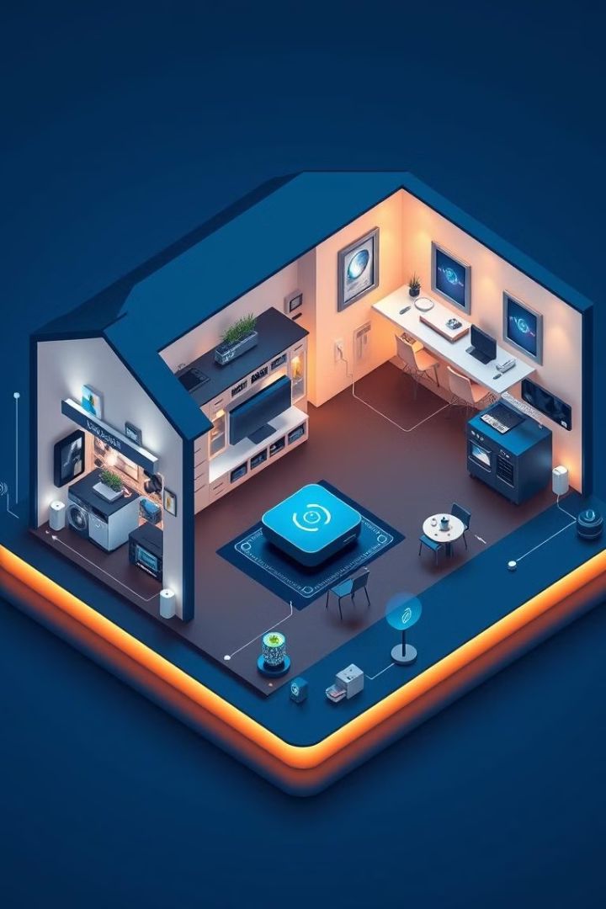



Goal of the Thesis
Primary Objective: To analyze smart home data and develop rules for automation that improve energy efficiency and comfort. Specific Goals:
Identify Key Data Types
Analyze Usage Patterns
Develop Automation Rules
Notes:
In today's world, we're seeing a rapid increase in the use of IoT technologies in homes. These technologies have great potential to improve energy consumption, create greater comfort, and enhance security. The main goal of this thesis is to analyze smart home data and develop automation rules that lead to improved energy efficiency and resident comfort. To achieve this goal, we pursued three specific objectives: 1. Identify the key data types collected in smart home systems. 2. Analyze the usage patterns of various appliances and systems. 3. Develop intelligent automation rules based on data analysis.

Slide 3
Methods
Step | Action | Tools Used | Outcome
Research Approach | Mixed-method combining quantitative analysis and rule-based modeling | - | Framework to identify patterns and create rules
Data Collection | Collected data from Kaggle smart home dataset spanning 2020-2023 | Dataset from Kaggle | Comprehensive dataset with 49,000 rows Accident Sample: 10000
Data Processing | Cleaned and processed data | Python, Pandas | Clean, structured dataset for analysis
Data Visualization | Generated visual insights | Matplotlib | Graphs and charts showing energy usage patterns
Dashboard Design | Designed real-time monitoring dashboard | Grafana | Interactive dashboard for real-time monitoring
Original dataset is available at: https://www.kaggle.com/datasets/pythonafroz/smart-home-dataset?resource=download
Notes:
To conduct this research, we used a mixed-methods approach that combined quantitative analysis and rule-based modeling. We collected data from a publicly available Kaggle dataset, which included information on energy consumption, appliance usage, and more. We then cleaned and processed the data, and performed the necessary analyses using tools like Python and Pandas. For data visualization, we used Matplotlib and created a dashboard in Grafana to monitor system performance in real-time. The mixed-methods approach helped us both identify quantitative patterns and develop automation rules based on the knowledge gained.

Slide 4
Results
Identify Key Data Types (Objective 1):
My initial code snippet categorizes columns into 'Sensor Data', 'Energy Metrics', and 'User Interaction Data’.
Analyze Usage Patterns (Objective 2):
The plot_energy_consumption_trends(), plot_appliance_usage_patterns(), plot_energy_correlation(), and analyze_peak_vs_offpeak_usage() functions are excellent examples of analyzing patterns in device usage and energy consumption.
Develop Automation Strategies (Objective 3):
The functions energy_optimization_rule(), predictive_maintenance_rule(), and offloading_rule() demonstrate the development of intelligent automation rules.
Notes:
Identify Key Data Types:
My initial code snippet categorizes columns into 'Sensor Data', 'Energy Metrics', and 'User Interaction Data'. This directly addresses the objective of examining and categorizing various data types collected from smart home systems.
Analyze Usage Patterns:
The plot_energy_consumption_trends(), plot_appliance_usage_patterns(), plot_energy_correlation(), and analyze_peak_vs_offpeak_usage(), theses functions are excellent examples of analyzing patterns in device usage and energy consumption. I visualized trends and correlations, which helps in detecting inefficiencies and understanding usage patterns.
Develop Automation Strategies:
My functions energy_optimization_rule(), predictive_maintenance_rule(), and offloading_rule() demonstrate the development of intelligent automation rules.
The machine learning models (Decision Tree and Random Forest) for predicting offloading decisions and real-time offloading are examples of AI-driven automation frameworks.
The visualizations comparing original and optimized/scheduled energy consumption show an initial step towards evaluating the impact of these strategies.

Slide 5
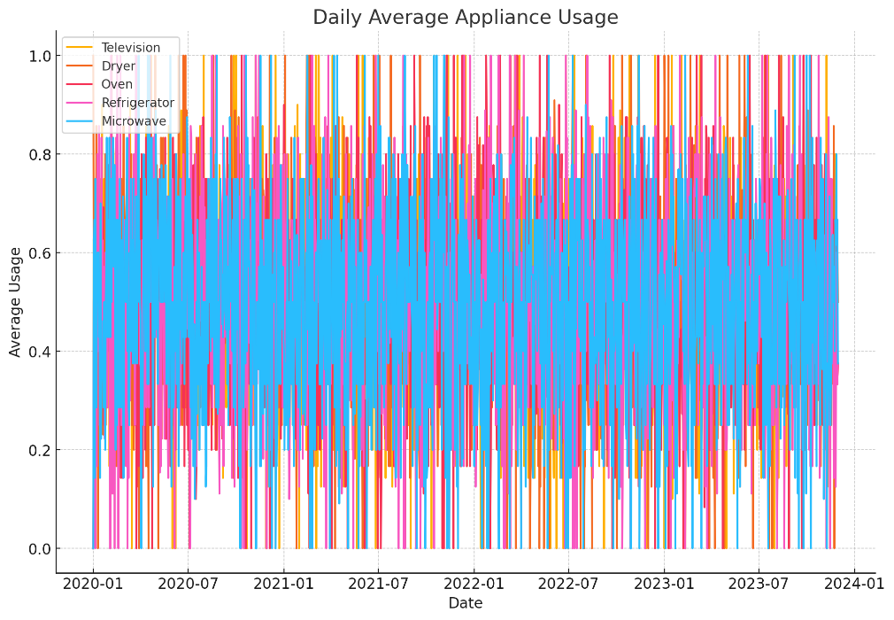
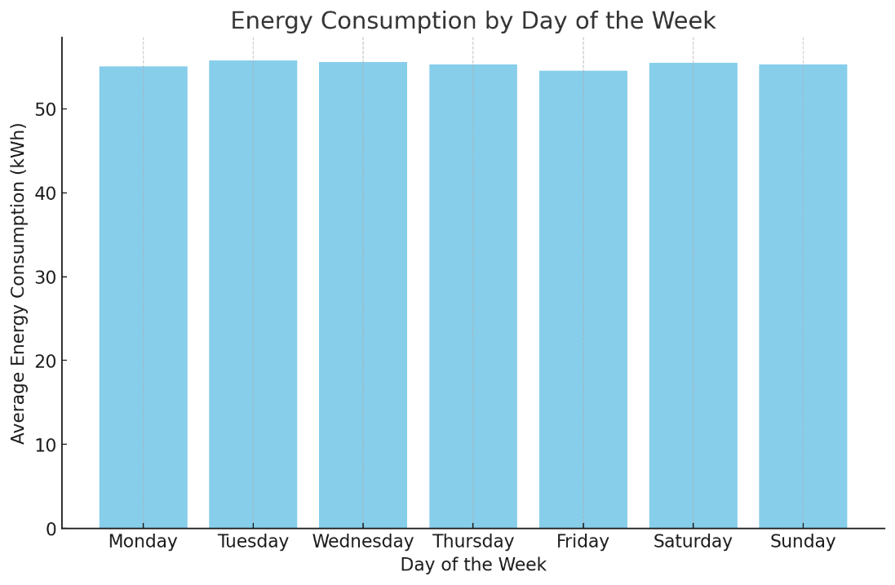
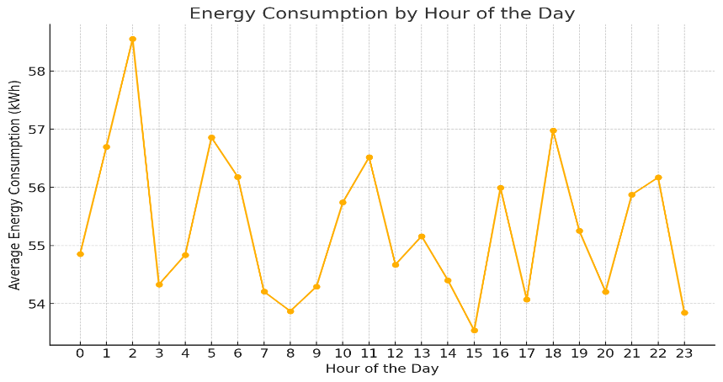
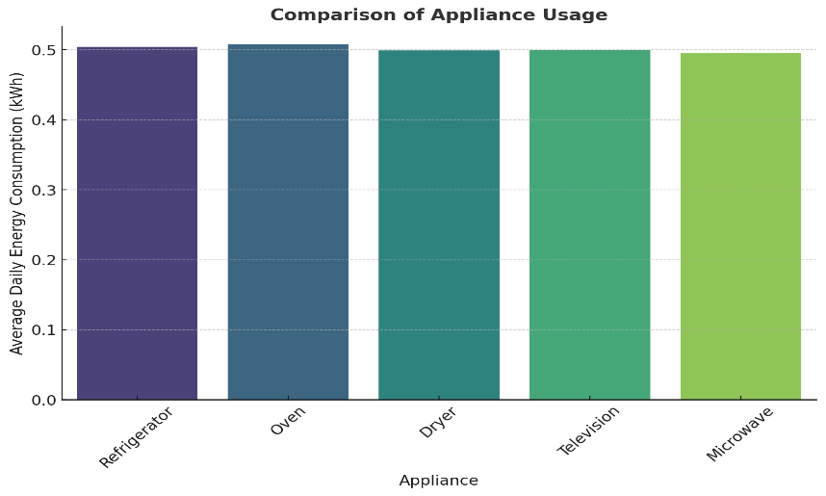
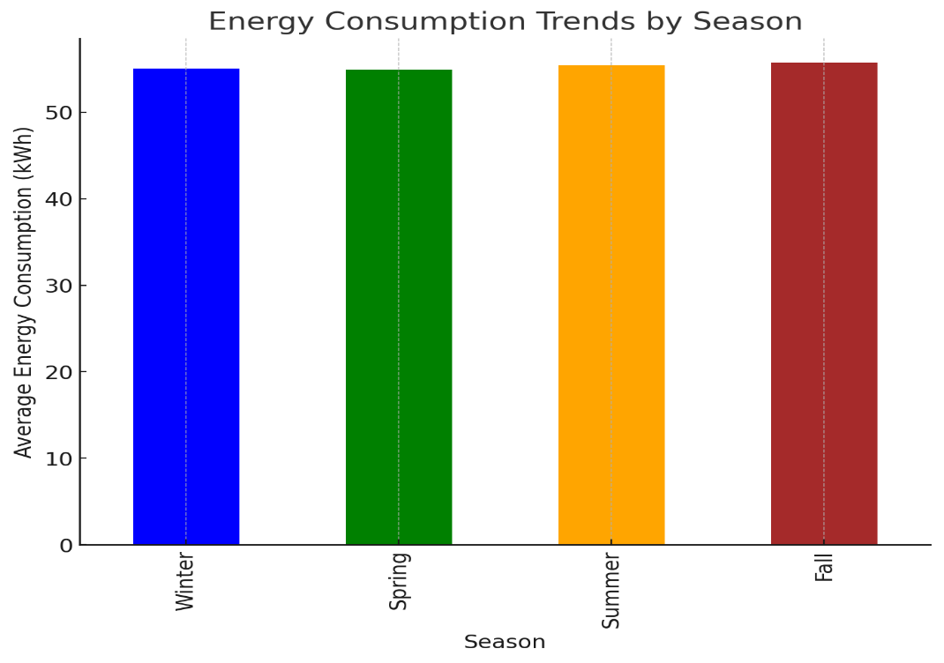
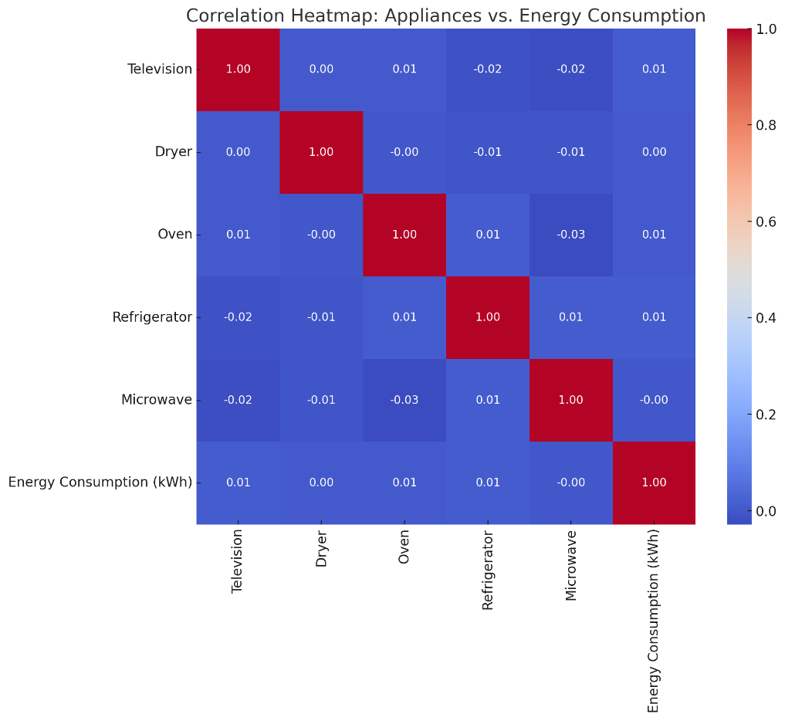
Findings for Objective 2
Patterns
Notes:
By analyzing the data, we identified various patterns in appliance usage and energy consumption. For example, we found that energy consumption is higher during peak hours (morning and evening) and lower on weekends. We also identified different seasonal patterns in energy consumption. These patterns helped us develop strategies for optimizing energy consumption.

Slide 6
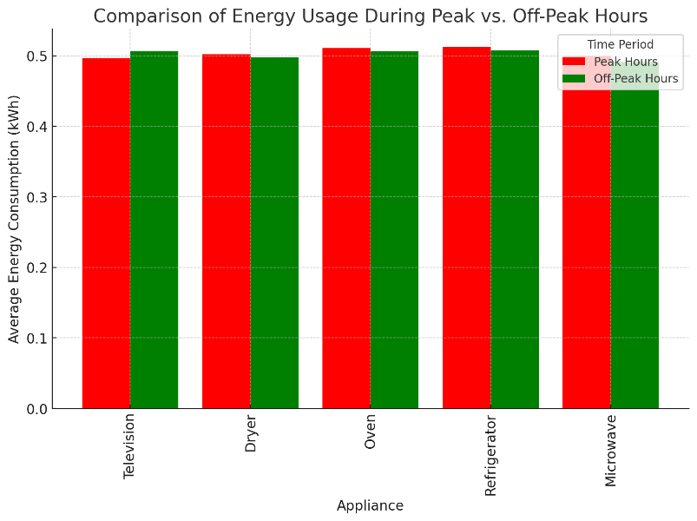
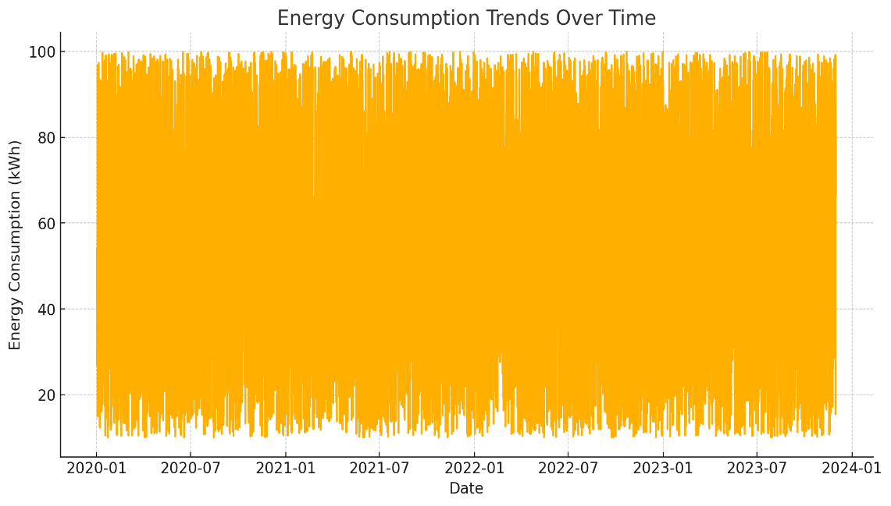
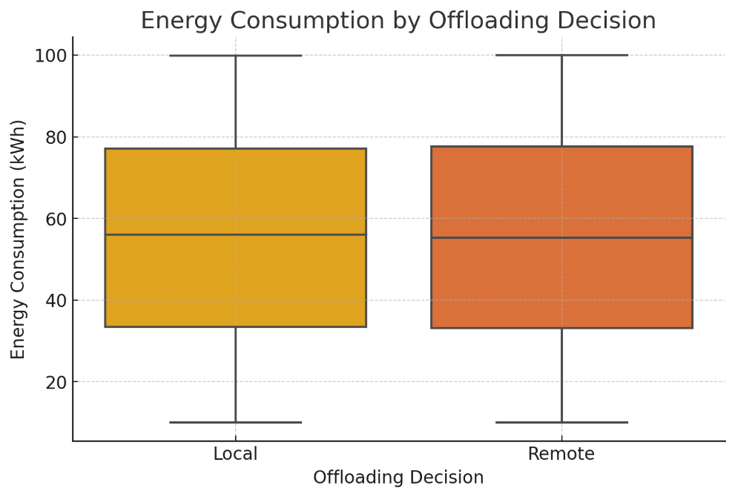
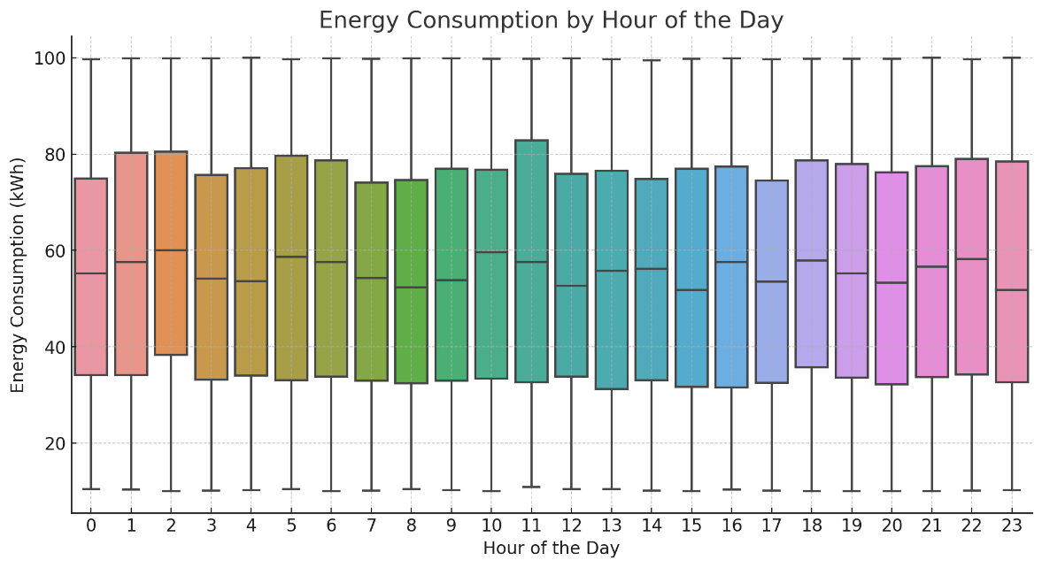
Findings for Objective 3
Real-time monitoring and expected outcomes
Notes:
The simulation results show that the automation rules we developed can significantly reduce energy consumption. For example, in the charts, you can see that energy consumption during peak hours decreased after applying the automation rules. We also found that automation rules can help improve system responsiveness and increase user satisfaction.

Slide 7
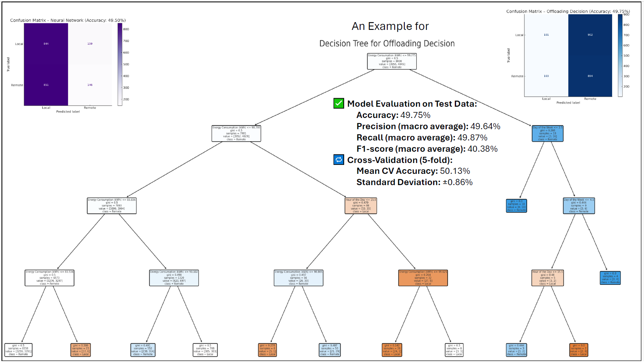
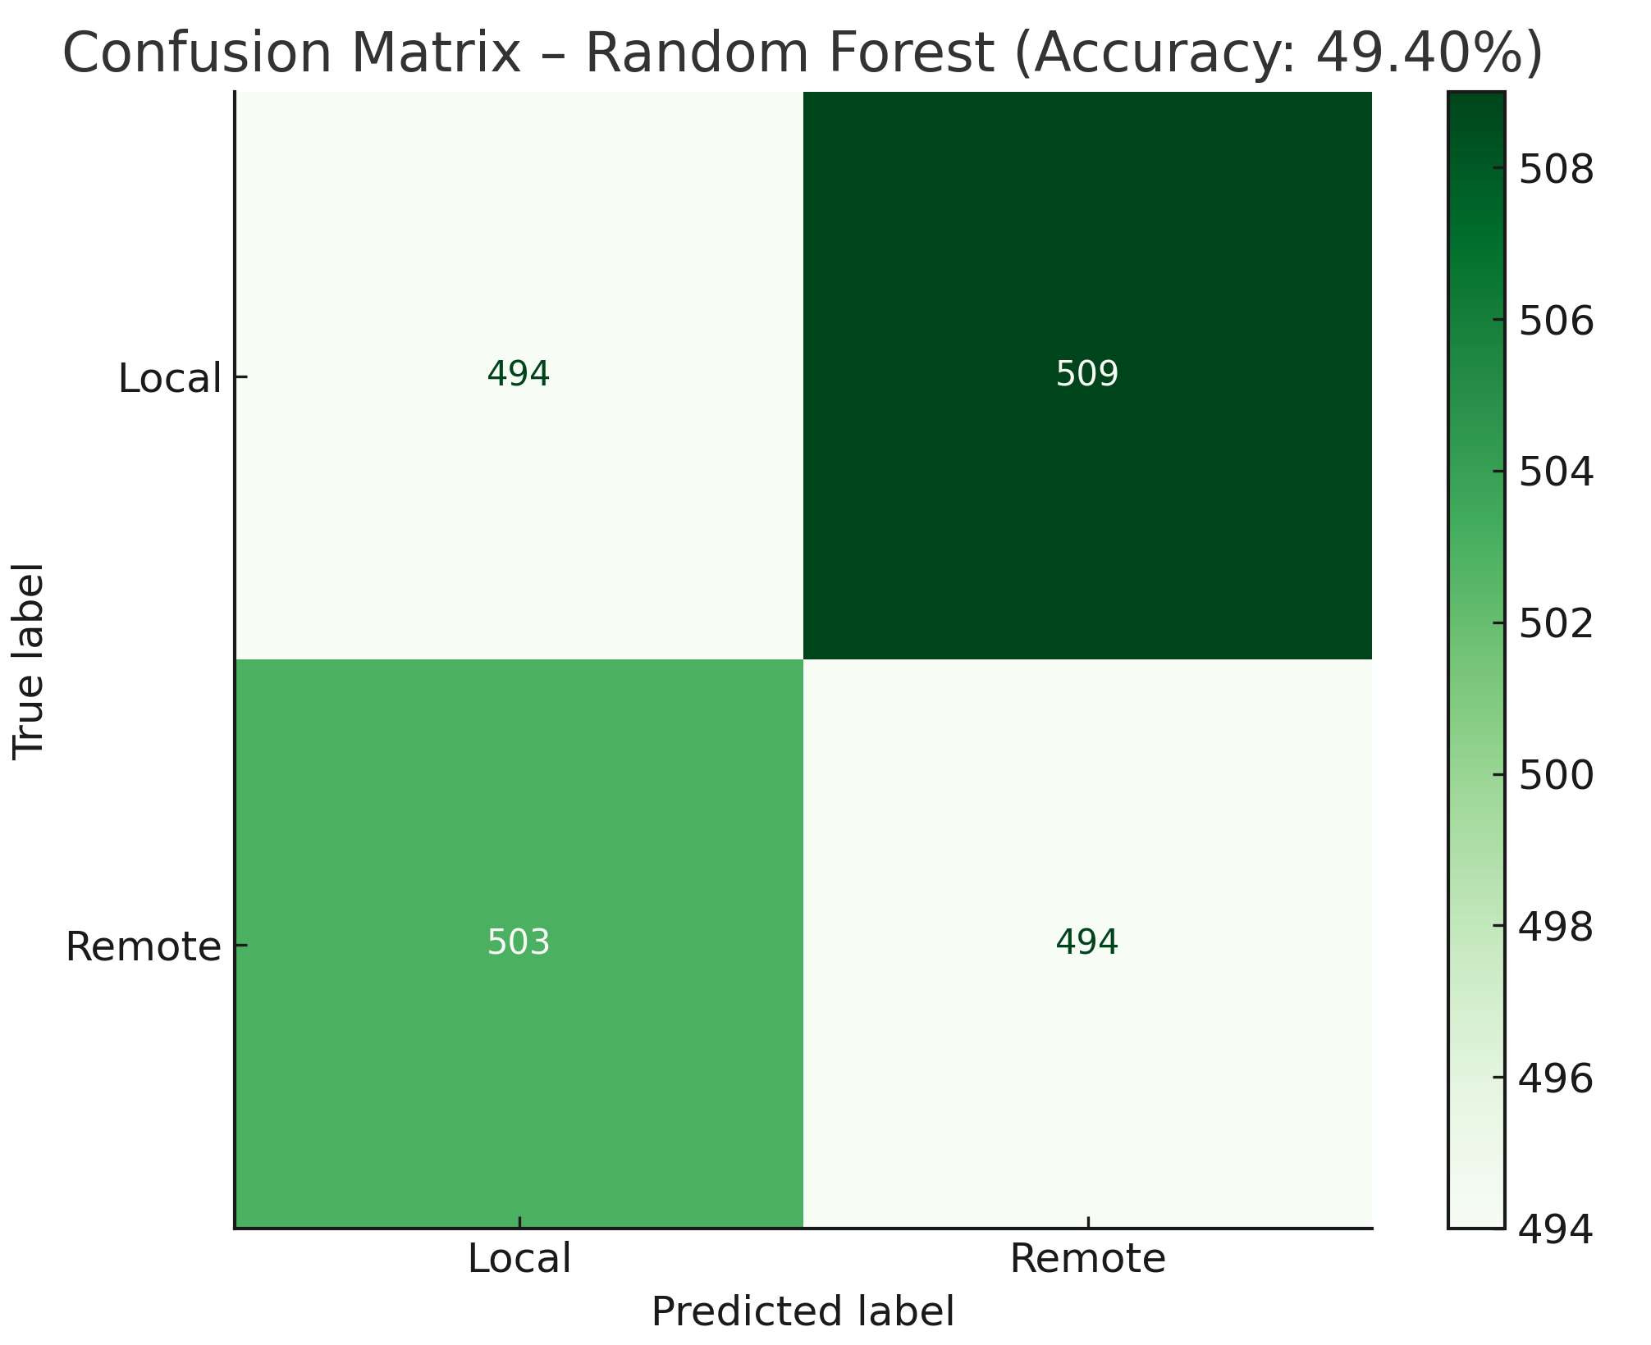
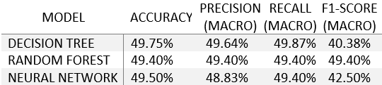
Findings for Objective 3
Notes:
The model makes the Offloading Decision (Local, Remote, or Hybrid) based on features such as energy consumption (kWh), hour of the day, month, and day of the week by learning patterns from historical data using supervised learning techniques. In this chart, the Confusion Matrix of the Decision Tree model for predicting the Offloading Decision is shown. It illustrates how accurately the model classified the categories: Local, Remote, and Hybrid. The values along the main diagonal (from top-left to bottom-right) represent the correct predictions. The final model accuracy is approximately 49.75%. While not highly accurate, this result reflects the complexity and variability of energy behavior data, and indicates opportunities for future model tuning or using ensemble methods like Random Forest.”
The Decision Tree model achieved approximately 49.75% accuracy on the test data. Precision and recall were nearly balanced (~49.6% and ~49.9% respectively), but the F1-score was lower at 40.38%, indicating room for improvement in model robustness. A 5-fold cross-validation confirmed consistent performance, with a mean accuracy of 50.13% and a standard deviation of ±0.86%, suggesting the model generalizes modestly but may benefit from more complex modeling techniques or richer features. The table highlights the challenge of modeling Offloading Decisions, as all three models.

Slide 8
Findings for Objective 3
Developing Automation Rules
Challenges | User Diversity - Varying user preferences and behaviors make one-size-fits-all automation ineffective.
 | Energy Efficiency - Fixed schedules may lead to energy wastage if they fail to adapt to dynamic conditions.
 | System Interoperability - Devices from different manufacturers often lack seamless integration, limiting automation potential.
Data Analysis Inputs | Temporal Trends - Identifying peak energy usage hours to optimize scheduling.
 | Behavioral Patterns - Analyzing appliance usage frequency to align with user habits.
 | Energy Consumption Metrics - Evaluating device-level consumption to develop optimization strategies.
Methodology | Data Analysis and Pattern Recognition - Leveraging insights from temporal and behavioral trends.
 | Rule-Based Modeling - Designing conditional logic-based rules for adaptive control.
 | Machine Learning Integration - Using predictive models to enhance automation decisions.
 | Simulation and Validation - Testing automation rules in simulated environments to assess effectiveness.
No | Rule | Condition | Action | Outcome
1 | Energy Optimization Rule | If the total energy consumption exceeds 10 kWh during peak hours. | Reduce power to non-essential devices and prioritize essential appliances. | Reduces peak load while maintaining essential operations.
2 | User-Centric Scheduling Rule | Based on user-specific behavioral patterns (e.g., frequent evening oven use). | Pre-schedule device operation during off-peak hours to match user habits. | Enhances user convenience while reducing costs.
3 | Predictive Maintenance Rule | If appliance energy usage deviates significantly from historical norms. | Trigger maintenance alerts to preempt potential failures. | Prolongs device lifespan and prevents energy wastage.
4 | Offloading Rule | When local processing bandwidth is constrained. | Offload tasks to remote servers, ensuring uninterrupted operation. | Improves system efficiency under high demand.
Notes:
Our third objective was to develop intelligent automation rules. For this purpose, we used various methods such as rule-based modeling and machine learning integration. We faced challenges such as the diversity of user preferences, energy inefficiencies caused by fixed scheduling, and problems related to device interoperability. To address these challenges, we used the collected data and the analyses performed and developed automation rules that can automatically adapt to different conditions. We tested the automation rules through simulation, and the results showed that these rules can lead to reduced energy consumption and improved user experience.

Slide 9
Conclusion
Data Insights Enable Optimization: Successfully identified and analyzed key smart home data types and usage patterns, revealing opportunities for energy efficiency improvements.
Intelligent Automation Strategies Developed: Designed and implemented rule-based and machine learning-driven automation strategies for energy optimization and predictive offloading.
Promising Model Performance: Achieved reasonable accuracy in predicting offloading decisions, demonstrating the potential of data-driven automation.
Foundation for Enhanced Smart Homes: The developed framework provides a strong basis for optimizing smart home functionality, leading to increased energy efficiency and user convenience.
Future Work: Further validation through broader simulations, exploration of advanced modeling techniques, and detailed impact assessment are planned to fully realize the potential of intelligent smart home automation.

Slide 10

Thank you
Q & A
Publication:
Houshangi, M; Novák, Vojtěch. “Optimizing Smart Home Automation through Data-Driven Insights and Business IoT Solutions”. IET Smart Cities, Under Review, 2025. Indexed in Scopus, Q1, Publisher John Wiley and Sons Inc.
Notes:
Thank you for your attention. I am now ready to answer your questions.

